Slide 1

Chandigarh University
Department of Mathematics
B.Tech. CSE (Core/DS/IT/CC)
Semester-3
Subject Code:25MTT-202
Discrete Mathematics
Chapter:1.1.1
Dr. SARTAJ
DISCOVER . LEARN . EMPOWER

Slide 2

CO mappings

Slide 3

CO-PO mappings
Note: Degree of relevance/correlation: 1-Low, 2-Medium, 3-High, Blank or ‘- ‘- Nil

Slide 4
Topics Overview
Propositions
Logical connections
Truth Table
Conclusions
Video links
References

Slide 5
Introduction to Propositions
A proposition is a declarative sentence (that is, a sentence that declares a fact) that is either true or false, but not both.
letters p, q, r, s, . . . . to denote propositional variables (or statement variables).
Examples:
(i) “2 + 2 = 4” (True)
(ii) “x + 3 = 5” is not a proposition unless x is known.

Slide 6
Introduction to Propositions
The truth value of a proposition is true, denoted by T, if it is a true proposition.
The truth value of a proposition is false, denoted by F, if it is a false proposition.
The area of logic that deals with propositions is called the propositional calculus (or propositional logic).

Slide 7
Introduction to Propositions
Propositions | Non-Propositions
5 is an even number | What time is it?
Paris is the capital of France | Read this carefully.
The Earth is round | x + 1 = 2.
The Sun rises in the east | x + y = z.

Slide 8
Compound Propositions
Many mathematical statements are constructed by combining one or more propositions.
New propositions formed from existing propositions p, q, r, s, . . . . using logical operators (called connectives) are called compound propositions.

Slide 9
Logical Connectives
¬p: Negation (not p)
p ∧ q: Conjunction (p and q)
p ∨ q: Disjunction (p or q)
p → q: Implication (if p, then q)
p ↔ q: Biconditional (p iff q)

Slide 10
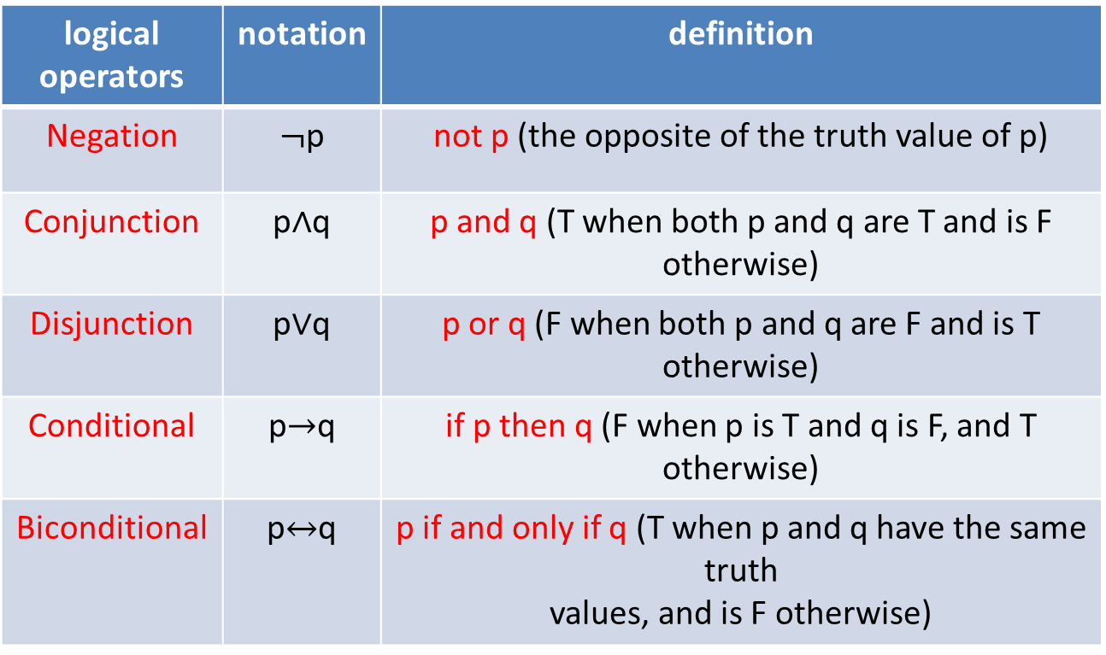
Table for Logical Connectives
logical operators | notation | definition
Negation | $¬$p | not p (the opposite of the truth value of p)
Conjunction | p$∧$q | p and q (T when both p and q are T and is F otherwise)
Disjunction | p$∨$q | p or q (F when both p and q are F and is T otherwise)
Conditional | p$→$q | if p then q (F when p is T and q is F, and T otherwise)
Biconditional | p$↔$q | p if and only if q (T when p and q have the same truth values, and is F otherwise)

Slide 11
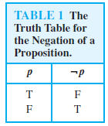
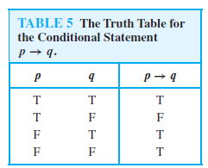
Truth Tables

Slide 12
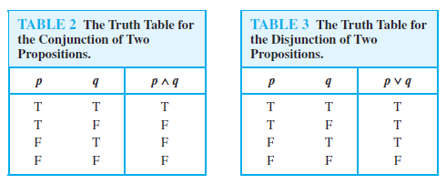
Truth Tables

Slide 13
Truth Tables
If and only if (⇔) − A⇔B is bi-conditional logical connective which is true when p and q are same, i.e. both are false or both are true. The truth table is as follows −
p | q | p ⇔ q
T | T | T
T | F | F
F | T | F
F | F | T

Slide 14
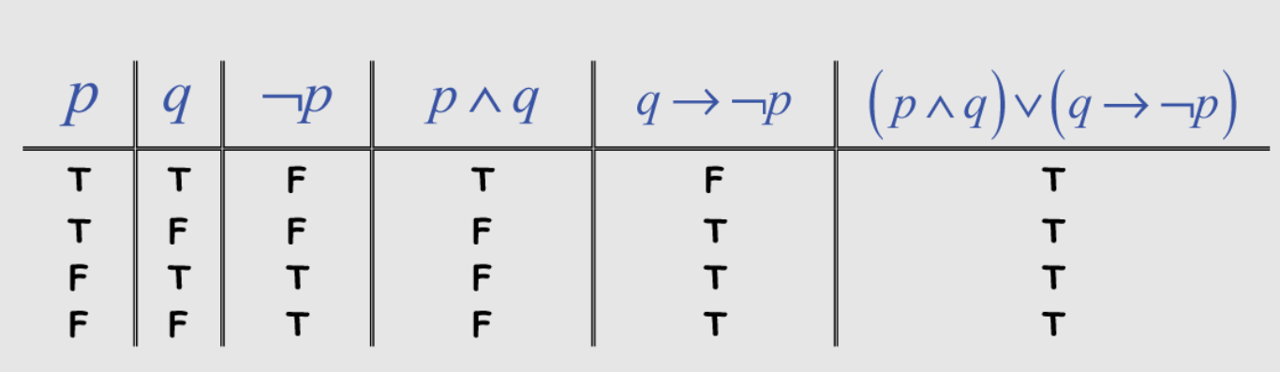
Table for Logical Connectives
Example of Truth Table for Logical Connectives:

Slide 15
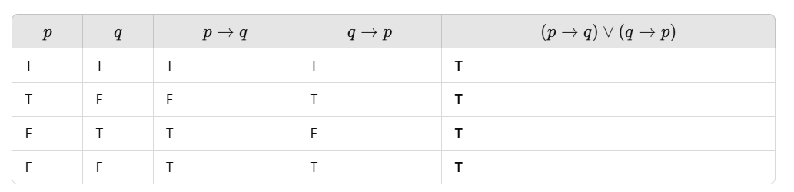
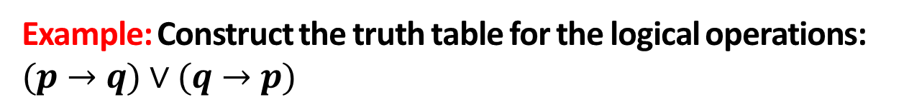
Example: Construct the truth table for the logical operations: $(p→q)∨(q→p)$
Table for Logical Connectives
ns

Slide 16
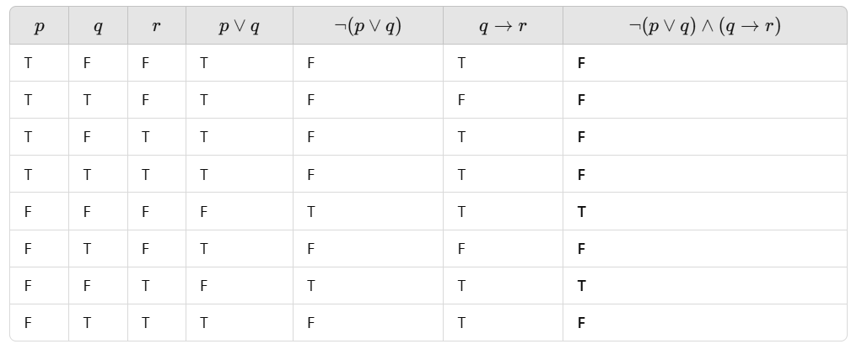
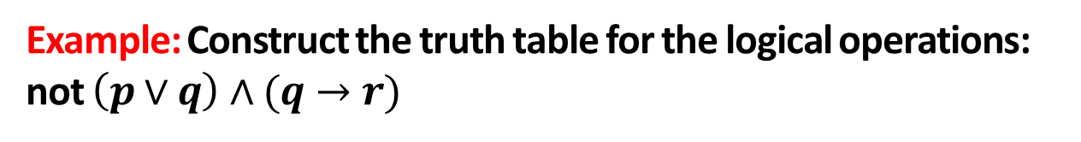
Table for Logical Connectives
Example: Construct the truth table for the logical operations: not $\left(p∨q\right)∧(q→r)$

Slide 17
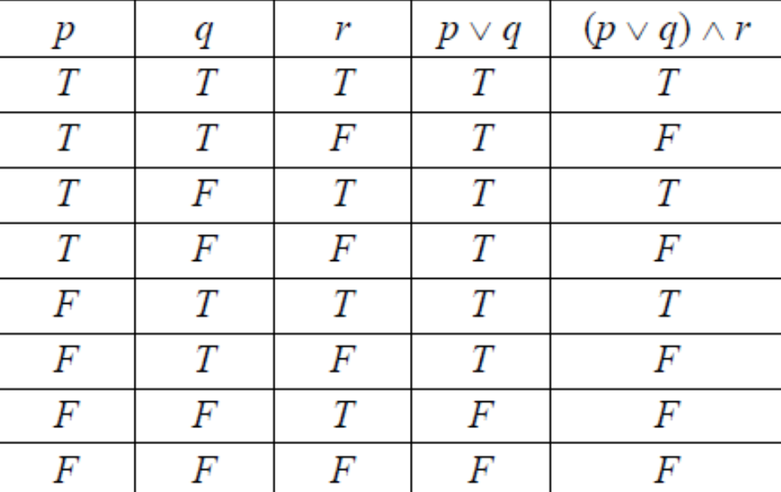
Table for Logical Connectives
Example of Truth Table for Logical Connectives:

Slide 18
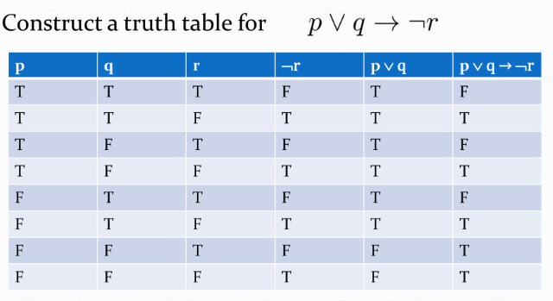
Table for Logical Connectives

Slide 19

Activity-1
1. Construct the truth table of the given compound proposition:
2. A restaurant has a special offer on two food items: Pizza and Burger.
A customer can get a free drink if they order either a pizza or a burger, but not both.
If they order both items or neither, they do not get a free drink.
Question: Construct a truth table to determine when a customer will receive a free drink based on their order choices.

Slide 20
Conclusion
Propositions have been discussed.
Logical connections have been presented.
Truth Table has been presented.
ns

Slide 21
Video Links
https://www.youtube.com/watch?v=zhKu0lQW0a8&list=PLFW6lRTa1g83LYdhDkUQfkXs7EbMBwYuF
https://youtu.be/E40r8DWgG40?si=xdQYxAO2ykEdTx9h

Slide 22
References
Sr. No. | Author | Name of the Book | Publisher | Year of Publication
1 | Kenneth H. Rosen | Discrete Mathematics and Its Applications | McGraw-Hill | 2019
2 | C. L. Liu | Elements of Discrete Mathematics | McGraw-Hill | 1996
3 | J. P. Tremblay, R. Manohar | Discrete Mathematical Structures with Applications to Computer Science | Tata McGraw Hill | 2001
4 | Kolman, Busby, Ross | Discrete Mathematical Structures | PHI | 2001
5 | Narsingh Deo | Graph Theory with Applications to Engineering and | PHI | 2017

Slide 23
Thanks!!!

